Slide 1
Types of components

Slide 2
Function and Class Components
Components let you split the UI into independent, reusable pieces, and think about each piece in isolation.
When we think about stateful and stateless components, we can ignore any framework entirely until it comes to implementation and think about JavaScript functions.
Impure Function = Class Component
Pure Function = Function Component
Notes:
Conceptually, components are like JavaScript functions. They accept arbitrary inputs (called “props”) and return React elements describing what should appear on the screen.

Slide 3
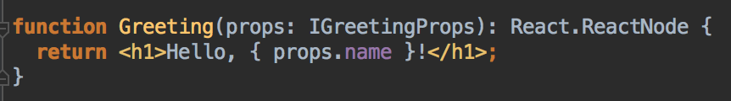
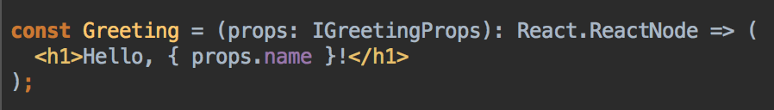
Function component
The simplest way to define a component is to write a JavaScript function:
Notes:
This function is a valid React component because it accepts a single “props” (which stands for properties) object argument with data and returns a React element. We call such components “function components” because they are literally JavaScript functions.

Slide 4
You may find functional components referred to as stateless, dumb or presentational in other literature. All these names are derived from the simple nature that functional components take on.
=> Functional because they are basically functions
=> Stateless because they do not hold and/or manage state
=> Presentational because all they do is output UI elements

Slide 5
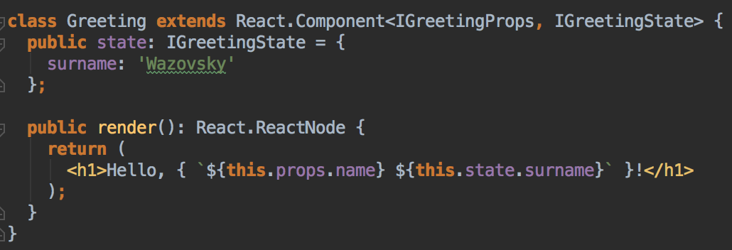
Class Component
Components can also be written using ES6 classes instead of functions. Such components are called class components.
Notes:
Component class is a bit more complicated. It has a state, lifecycle hooks and it is a javascript class which means that React creates instances of it. React should initialise the component class in order to call lifecycle hooks, call a constructor, initialise state and more.

Slide 6
As you explore other resources, you might find class components referred to as smart, container or stateful components.
=> Class because they are basically classes
=> Smart because they can contain logic
=> Stateful because they can hold and/or manage local state
=> Container because they usually hold/contain numerous other (mostly functional) components

Slide 7
Difference between stateless and stateful components
Functional (stateless)
Class (stateful)
Receive props as Argument
Access props via this.props
No Internal State
Manage Internal State(this.state)
No Lifecycle Methods
Use Lifecycle Methods
Use as often as possible
Use only as containers

Slide 8
Presentation | Container
Are concerned with how things look | Are concerned with how things work
May contain both presentational and container components inside, and usually have some DOM markup and styles of their own | May contain both presentational and container components** inside but usually don’t have any DOM markup of their own except for some wrapping divs, and never have any styles
Often allow containment via this.props.children | Provide the data and behavior to presentational or other container components
Have no dependencies on the rest of the app, such as Flux actions or stores | Call Flux actions and provide these as callbacks to the presentational components
Don’t specify how the data is loaded or mutated | Are often stateful, as they tend to serve as data sources
Receive data and callbacks exclusively via props | Are usually generated using high order components such as connect()from React Redux, createContainer() from Relay, or Container.create() from Flux Utils, rather than written by hand
Rarely have their own state (when they do, it’s UI state rather than data)
Are written as functional components unless they need state, lifecycle hooks, or performance optimizations
Notes:
You’ll find your components much easier to reuse and reason about if you divide them into two categories: Container and Presentational.

Slide 9
Benefits of This Approach
Better separation of concerns. You understand your app and your UI better by writing components this way.
Better reusability. You can use the same presentational component with completely different state sources, and turn those into separate container components that can be further reused.
Presentational components are essentially your app’s “palette”. You can put them on a single page and let the designer tweak all their variations without touching the app’s logic. You can run screenshot regression tests on that page.
This forces you to extract “layout components” such as Sidebar, Page, ContextMenu and use this.props.children instead of duplicating the same markup and layout in several container components.

Slide 10
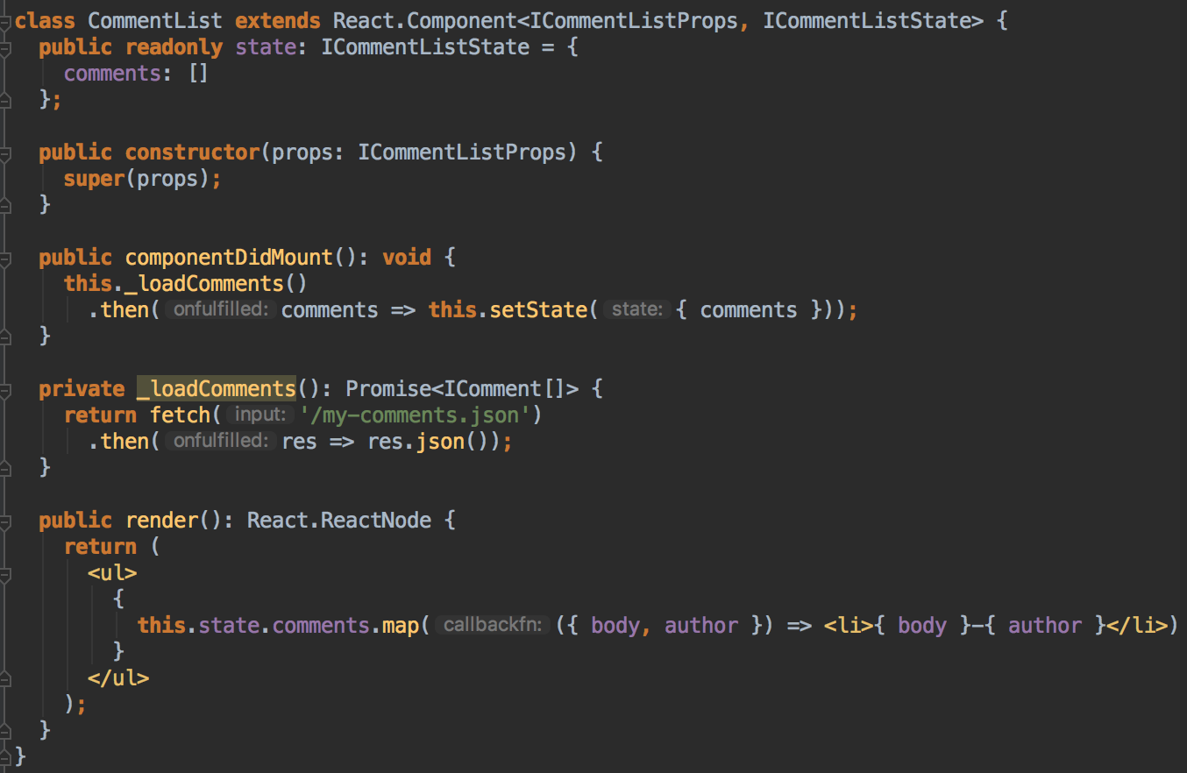
Notes:
I suggest you to start building your app with just presentational components first. Eventually you’ll realize that you are passing too many props down the intermediate components. When you notice that some components don’t use the props they receive but merely forward them down and you have to rewire all those intermediate components any time the children need more data, it’s a good time to introduce some container components. This way you can get the data and the behavior props to the leaf components without burdening the unrelated components in the middle of the tree.

Slide 11
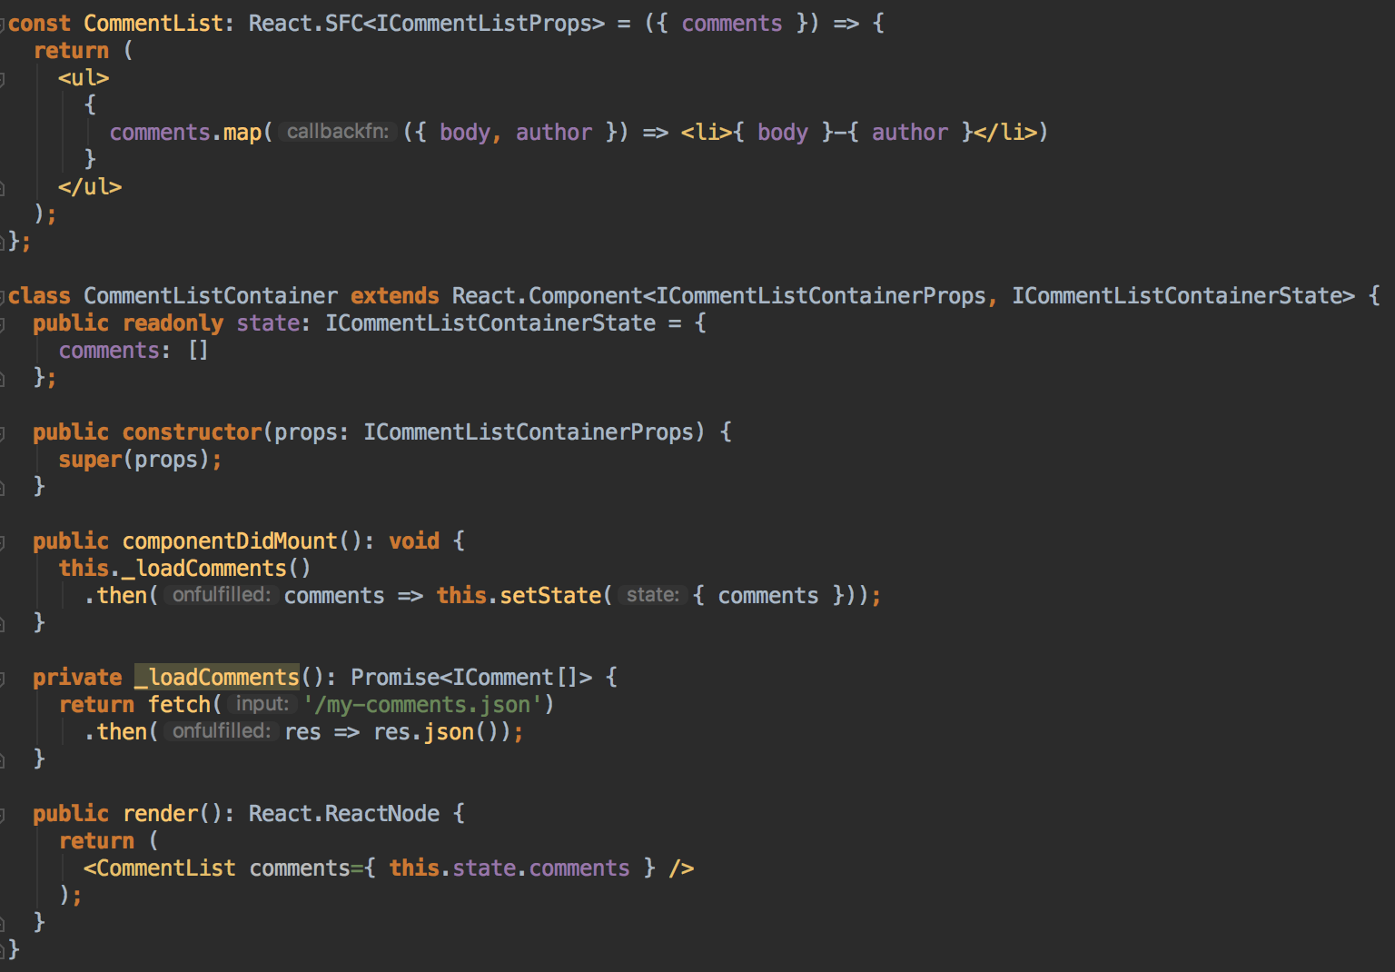
Notes:
We split previous component into two components. The first is like a traditional template, concerned only with presentation, and the second is Container component, tasked with fetching data and rendering the related view component.

